Slide 1

DKomplex Intelligent Machine Learning Forecast Models
Nicole Al-Sabah, Chika Starks, Deborah Shaw, Joshua Okero, Daniel Arias

Slide 2
Introduction
Objective
Approach
Build a robust forecasting solution using Azure AutoML and manual tuning to deliver accurate, reliable sales predictions for strategic decision-making
Identify top-performing models and feature sets, evaluate them with R², MAPE (Mean Absolute Percentage Error), and other metrics, and optimize for maximum prediction accuracy

Slide 3
Problem Statement
The client needs a reliable and accurate forecasting solution to predict future sales based on historical data and external factors. Inaccurate forecasts risk overstocking, understocking, and poor strategic planning

Slide 4
Solution
Use AutoML to identified top-performing models and features, and fine-tuned models for optimal performance
Azure AutoML
Azure Lakehouse
Model training, selection, hyperparameter tuning
Centralized data storage & processing
Evaluation Metrics
R², MAPE, MAE, RMSE
Python
Pandas, Scikit-learn
Data preprocessing & evaluation
Data handling & metric computation

Slide 5

Implementation Strategy
Collect & Clean Data
Engineer Key Features
Forecasting in AutoML
Validate & Compare Results
Reporting & Review
Combined over 10 years of historical sales data with external economic indicators.
Removed duplicates, handled missing values, and standardized formats.
Created time-based variables such as lags and seasonal patterns.
Integrated additional relevant indicators to strengthen predictive performance.
Used the time series forecasting module to automatically test and compare multiple models.
Selected the best-performing model based on metrics like R², MAPE, and RMSE.
Conducted additional manual analysis to compare model performance.
Compared short-term (3–6 month) and longer-term (12 month) forecasts for accuracy.
Saved models and predictions for future reuse.
Compiled performance metrics and forecasts into reports.
Shared results for review and feedback within the project and team.

Slide 6

Challenges
Impact
Solution
1
Data Quality Issues
Delays in preprocessing
Cleaned & standardized datasets
2
Platform Learning Curve
Slower initial progress
Spent time on tutorials and test runs
3
Technical Limitations
Scheduling conflicts for runs
Coordinated team schedules
4
Unfamiliar Data Fields
Unclear feature impact
Ran correlation analysis notebook to find best features
5
Model Testing Time
Long AutoML runs to find best model
Created and reviewed reports from multiple runs

Slide 7
What You’ll See
Load a client/product series
Choose forecast horizon (3/6/12 months)
Generate forecast with metrics
Export Excel report for stakeholders

Slide 8
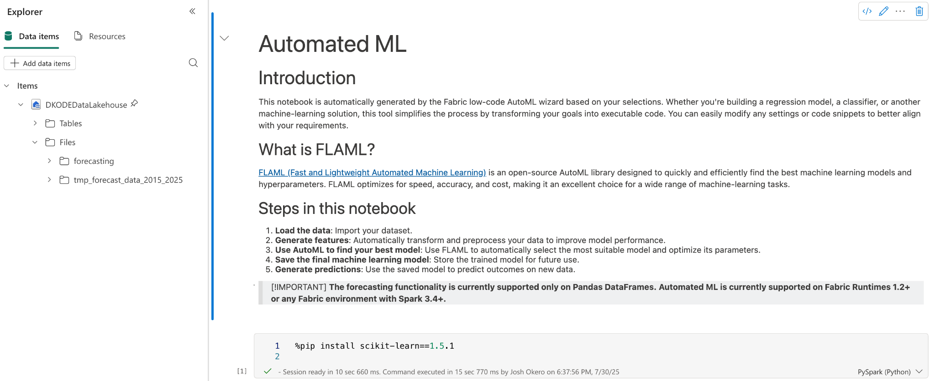
Open the Notebook, Select Data and Horizon
Connects to Microsoft Lakehouse
Pulls 10+ years of cleaned invoice data
Loads selected economic indicators

Slide 9
Behind the Scenes
Applies feature set: lags, rolling means, leading indicators
Runs registered AutoML model (FLAML in Fabric)
Uses time-based validation to avoid look-ahead bias

Slide 10
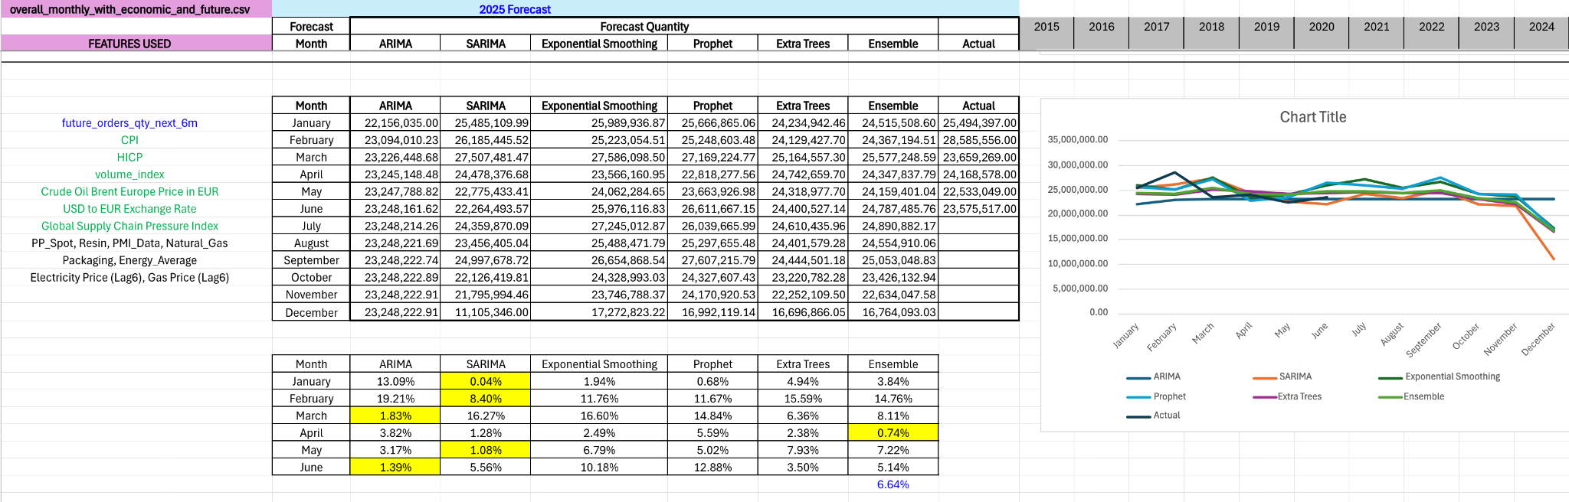
Metrics Snapshot and Forecasts
R² and MAPE displayed for test window
3–6 months: higher stability, business-aligned
12 months: lower R²—directional use
Line chart: forecast (solid)

Slide 11
What Changed Performance
Filters: outlier capping, date range
Feature choices > model swaps for MAPE
Results tracked in MLflow registry

Slide 12
Constraints We Solved
AutoML limits (ARIMA unsupported in UI)
One-notebook compute → scheduled runs
Data formatting/merges across sources

Slide 13
Why It Matters
Actionable monthly quantity forecasts
Repeatable pipeline for DKomplex and future cohorts

Slide 14
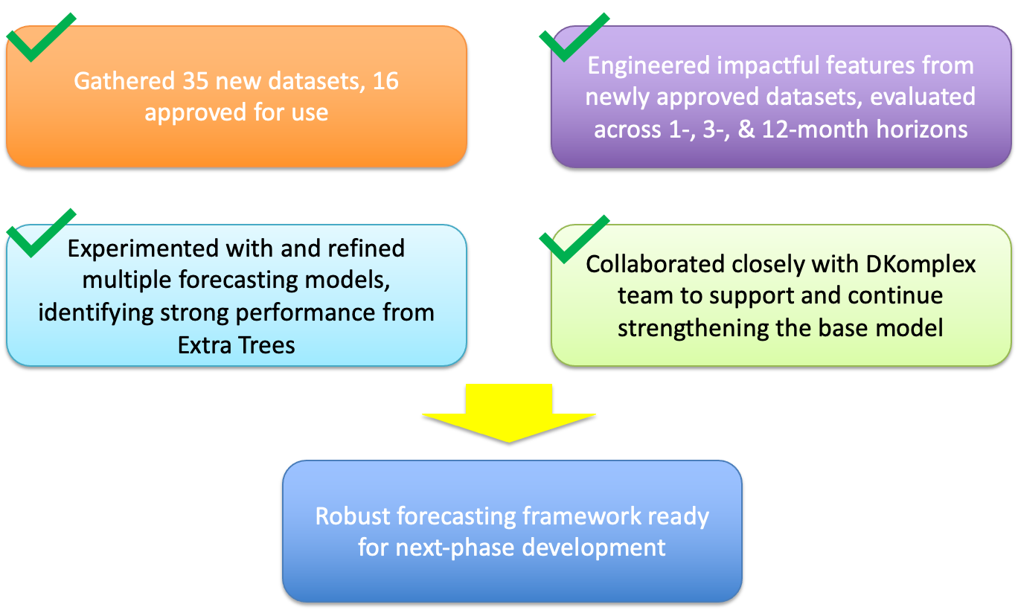
Conclusion/ Summary

Slide 15
Accomplishments
Gathering New Data: Collected and curated 35 new datasets, with 16 approved for modeling use
Feature Engineering: Engineered impactful features leveraging the approved datasets
Model Testing: Tested multiple forecasting models across 1, 3, and 12 month horizons
Algorithm Evaluation: Employed AutoML to evaluate diverse forecasting algorithms systematically
Collaboration: Collaborated closely with the DKomplex engineering team for guidance and fine-tuning
Documentation: Documented findings and detailed performance insights to support ongoing development

Slide 16
Future Work
We wanted our research to provide clear direction for developing the optimal PPU forecasting solution, with detailed performance insights to guide future development efforts.
To facilitate the knowledge transfer for future students, we’ve provided:
Excel reports with detailed insights and performance metrics
Microsoft Fabric notebooks with complete workflows
Comprehensive documentation for future teams
Clear guidance on most promising methodologies

Slide 17
Reflection
This project provided valuable hands-on experience with enterprise-level machine learning tools, such as Microsoft Fabric and Azure AutoML, as well as real-world forecasting challenges.
Managing shared resources and coordinating team workflows in a cloud environment provided valuable experience for future industry work.
Working with DKomplex's engineering team highlighted the importance of clear communication and iterative feedback in real-world projects.
Most importantly, this experience bridged the gap between academic machine learning concepts and practical business applications, preparing us to adapt our theoretical knowledge for real-world client solutions.

Slide 18
Thank You
Thanks to DKomplex teams for guidance and support
Thanks to CST 499 instructors and mentors for insight and feedback.
Thanks to our audience—questions welcome anytime.

